Slide 1

PRODYNA
THE POWER OF KNOWLEDGE GRAPHS

Slide 2
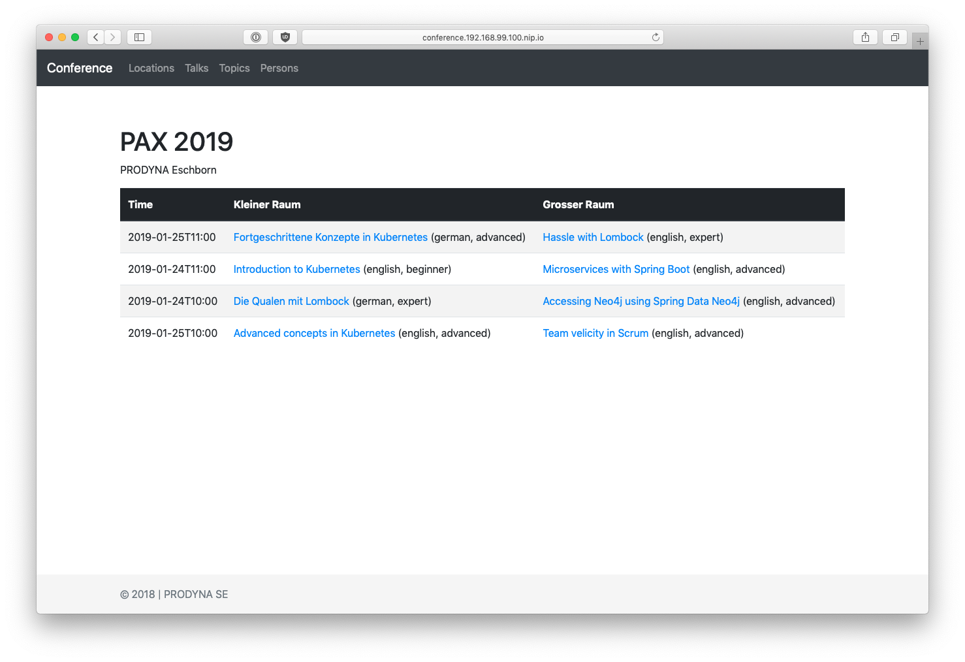
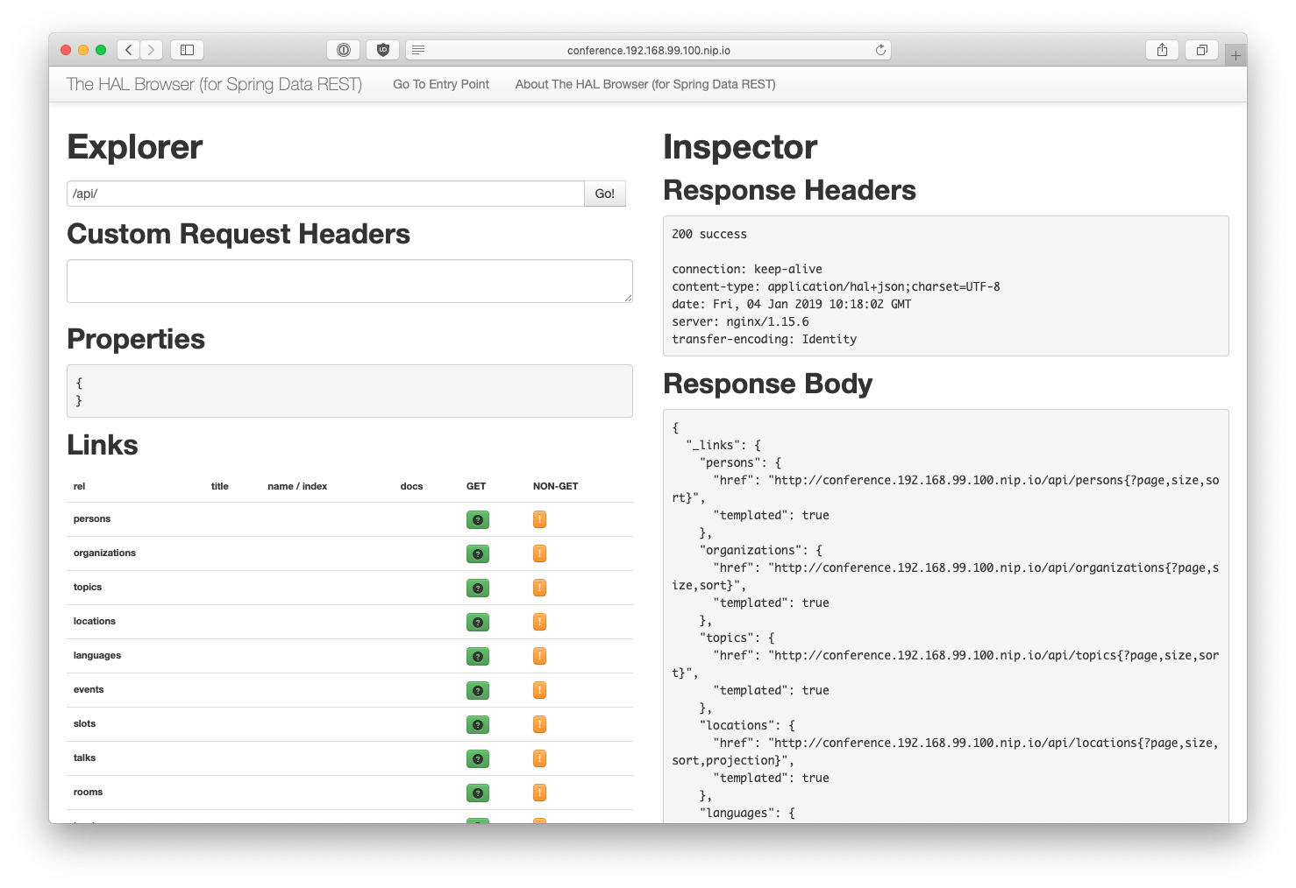
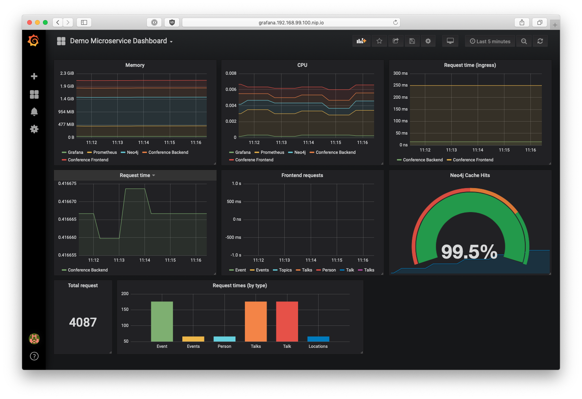
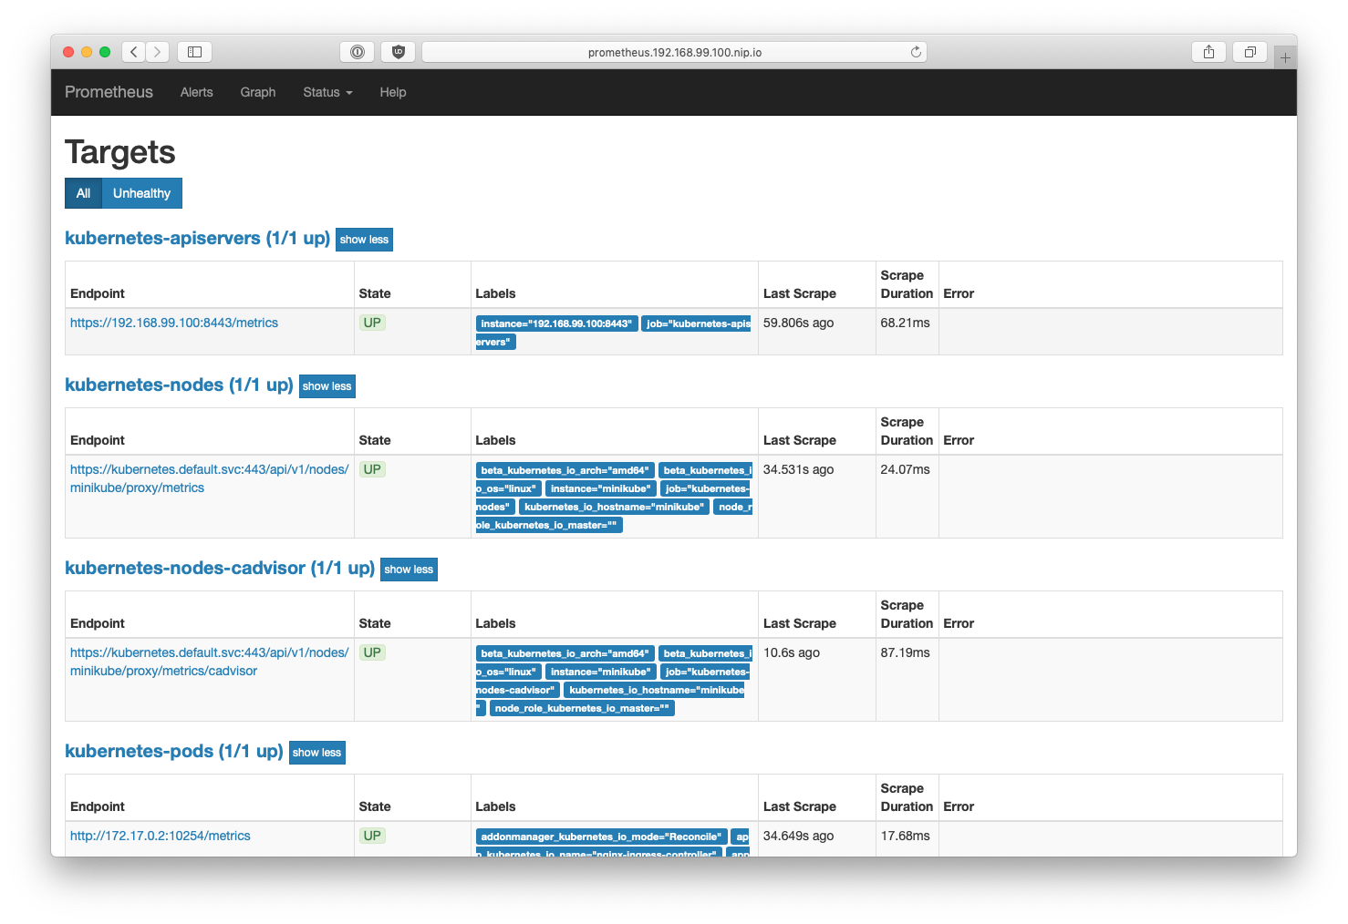
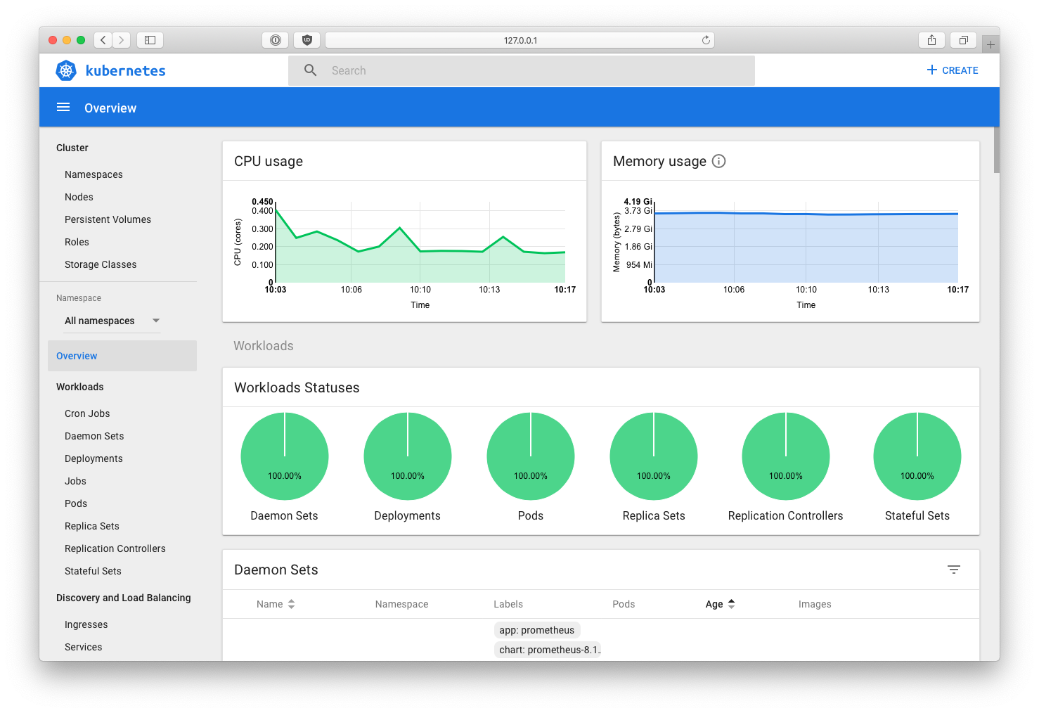
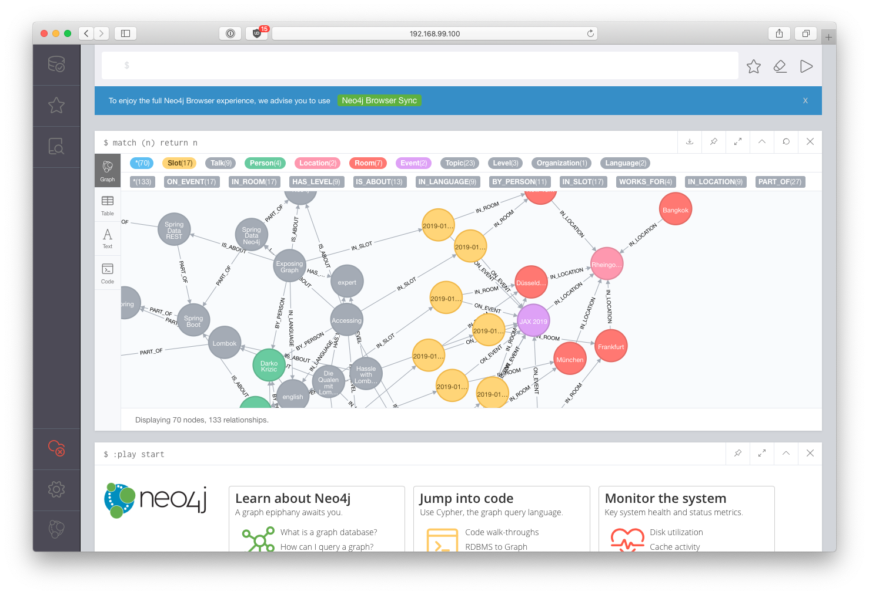
Conference
Frontend
http://conference.192.168.99.100/
Conference
Backend
conference/
80
conference/api
Ingress Controller
443
http://conference.192.168.99.100/api
Prometheus
prometheus
Dashboard
dyn
grafana
Neo4j
Grafana
http://grafana.192.168.99.100/
Conference
Data
32K
32K1
http://prometheus.192.168.99.100/
bolt://minikube:32001
http://minikube:2001/
Conference
Backend
Conference
Frontend
http://conference.192.168.99.100/api
http://minikube:32000
bolt://minikube:32001

